Slide 1

Citi Bike Usage Balancing through Congestion Pricing
Milestone 2 Presentation
Paul Griffioen and Anthony Jin

Slide 2
Decongesting the Citi Bike Network
Network Definition
Nodes = bike stations
Edges = trips between two bike stations
Dynamic, directed, and weighted
Citi Bike Network Simulator
Initialization procedure
Simulate current movement patterns
Introduce incentives to modify current movement patterns
Convex Optimization
Formulate objective function
Define constraints
Decongestion via convex optimization
Station A
Bike trip 3
Bike trip 1
Station B
Bike trip 2
Overview

Slide 3
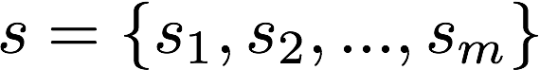
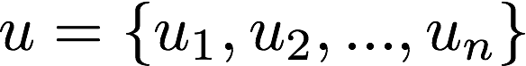
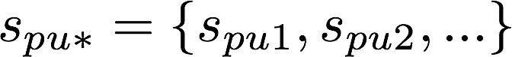
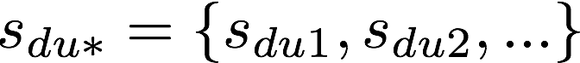
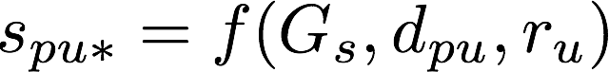
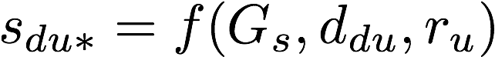

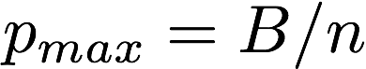

Problem Formulation
The System: a set of stations
The User: a set of active bikers
The Incentives
Recommend sets of candidate stations for pick-up and drop-off
Offer different payments
Approach

Slide 4

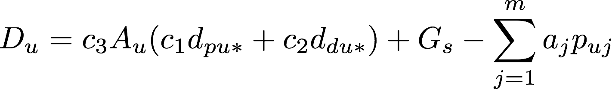
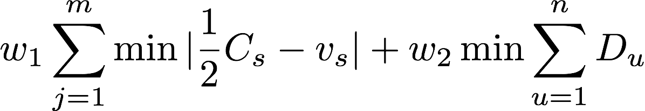
Convex Optimization
Objective: to minimize…
System congestion level
User dissatisfaction
Constraints
Maximum distance the user is willing to walk
Maximum number of bikes stored at each station
Budget available for each user
The Problem to Solve
Results

Slide 5
Network Simulation
No Incentives
Optimal Incentives
Results

Slide 6
Conclusion and Future Work
Proposed framework to decongest the Citi Bike network via convex optimization
Capable of simulating movement patterns for anytime throughout the year
Currently using optimal incentives with high probability
M3 Sneak Peek
Solve the convex optimization problem
Incorporate the solutions to the present framework
Conclusion

